Slide 1


Group T-D
Presentation
Measuring the Velocity of a Moving Block

Slide 2


Introduction
Measuring the velocity of moving objects is a crucial task in various applications. In this project, we present a method for measuring the velocity of a moving object using Arduino Uno and Infrared (IR) sensors.
The IR sensors are used to detect the presence of an object and calculate the time taken by the object to pass between two sensors.
Using this time, we can calculate the velocity of the object, and by writing code for the Millis () function, we can determine the object's velocity.
Overall, this project aims to discuss the components and setup required to implement this velocity measurement system using Arduino Uno and IR sensors.

Slide 3

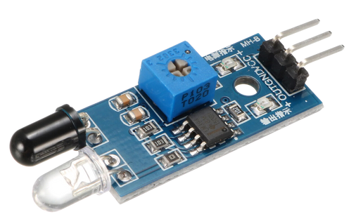
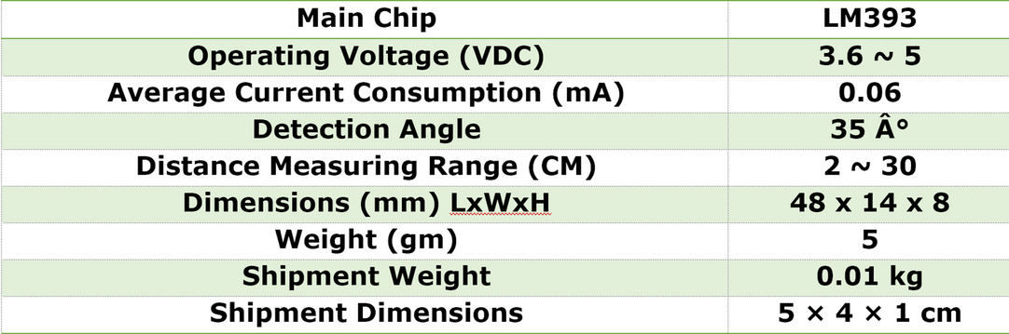
Components Used
1. Arduino UNO
2. LCD 16X4
3. Breadboard
4. Jumper wires
5. Wooden Platform with 3D printed edge
6.2 IR sensor – HW201
7. Resistor – 1k
8. USB Cable
9. Infrared distance sensor, model HW-201
IR Sensor -
The emitter (black LED) emits infrared light (invisible to the naked eye). If it is reflected on a nearby object, the receiver (transparent LED) captures it and provides a voltage proportional to the amount of light received.
The received light value is internally compared with an adjustable threshold (with the potentiometer) and the output signal is activated or not, to report the proximity of the object.
IR HW-201
LM393

Slide 4
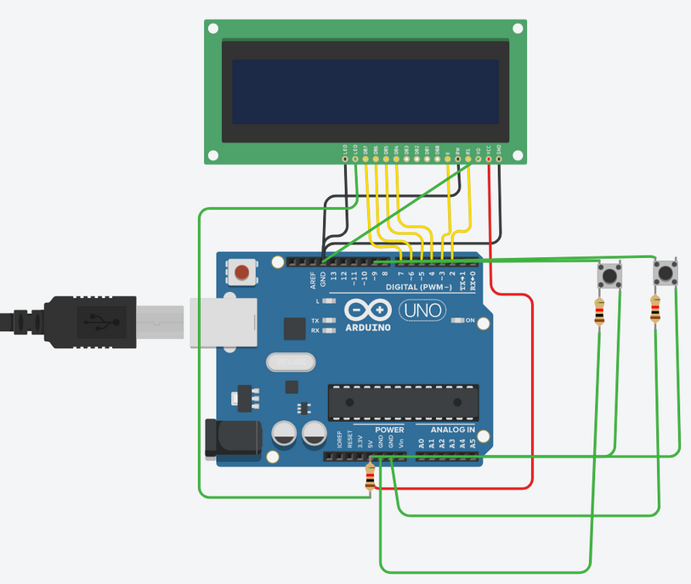
Working
code
code explain in 2-3 liens
`
`
`
`
`

Slide 5
Further
Why IR over Ultrasonic
Limitations
Ultrasonic sensors use sound waves to detect objects in their vicinity. They emit high-frequency sound waves and measure the time it takes for the waves to bounce back from an object, allowing them to calculate the time between the sensor and the object.
IR sensors, on the other hand, use infrared light to detect objects. Sensors are generally more precise than ultrasonic sensors and are unaffected by environmental factors such as wind or noise.
When we used ultrasonic sensors, the major limitation was the delay between two consecutive readings. Experimentally, it was found that if any object runs in time less than 644 milliseconds, our sensors are unable to detect it. And thus, we needed to shift to IR sensors.
Limited range: The range of IR sensors used is fixed at - for distance between two sensors to be 5.8cm. If we take less than that, the range will overlap.
Limited detection speed: IR sensors may have difficulty detecting fast-moving objects due to their limited detection speed.
The maximum speed it can calculate as for these IRs used is 875cm/s.
The diameter of object can't be less than 0.45cm to be detected by sensors used.
Interference: IR sensors can be affected by ambient light sources like sunlight, fluorescent lights, and incandescent bulbs. These light sources can cause interference and affect the accuracy of the sensor readings.

Slide 6

Summary
We encountered some limitations and all
ovrall this is our porejct
So with this project, we could measure the velocity of a moving object easily within the limits of errors. It can be used outside to measure the velocity of cars or balls thrown in sports during rainy seasons when sunlight is not a problem for IR Sensors. Else, with other sensors and better precisions used, it can be used at various places to calculate how fast an object is moving.

Slide 7
Thank You
Deekshita 2021MEB1292
Mitta Vasavi 2021MEB1297
Navrinder Singh 2021MEB1302
Pratima 2021MEB1308
Sachin 2021MEB1314

